Slide 1
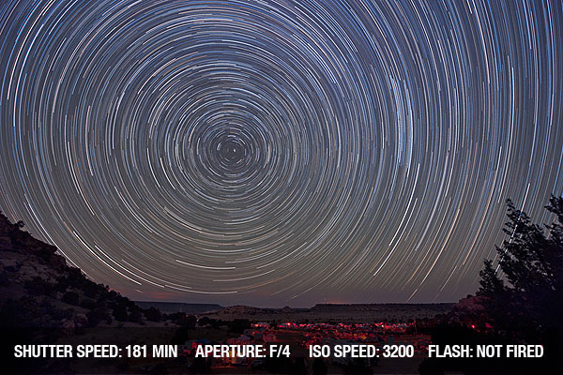
Lecture 4- Observable effects in Rotating Frame
Notes:
Show the video of how Coriolis effect affect the weather pattern and create hurricanes.

Slide 2
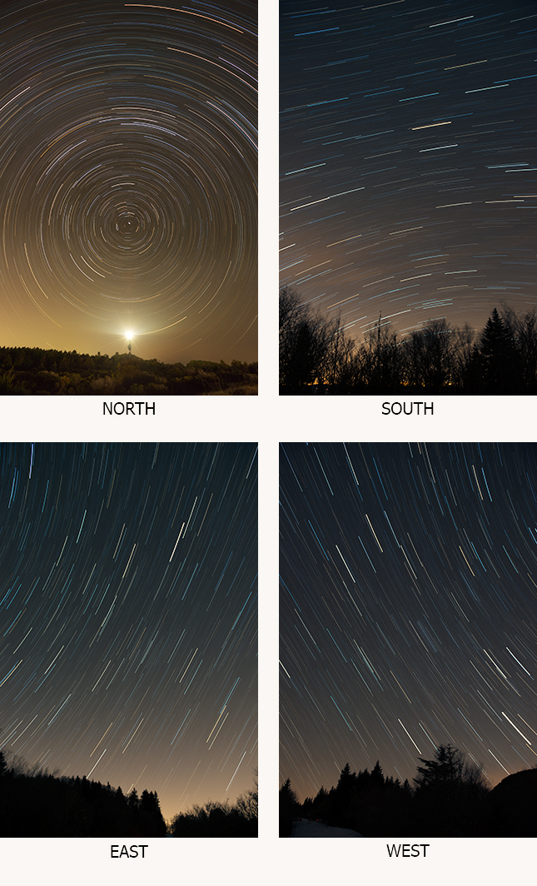
Observation in Rotating Frame
Notes:
Photos taken at 35 degree lattitude

Slide 3
Velocity in Inertial and Rotating Frame
Coirolis Theorem
Velocity measured in the rotating frame
Apparent Velocity of the point of interest with respect to rotating frame
Notes:
In the text book r-r’ is given as positive which is not correct. Omega cross r should be minus. So our treatment here is valid.

Slide 4
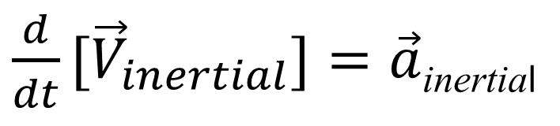
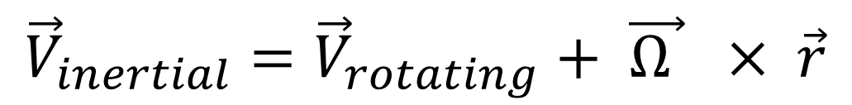
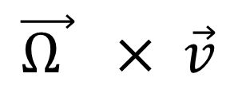
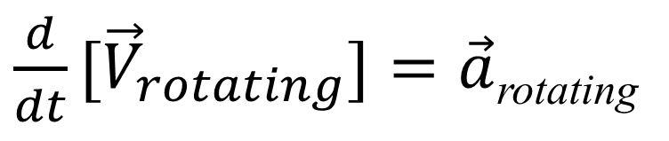
Acceleration in Inertial and Rotating Frame
$${\vec{V}}_{inertial}={\vec{V}}_{rotating}+ \vec{Ω } × \vec{r}$$
$\frac{d}{dt}{[\vec{V}}_{inertial}]=\vec{a}$_{inertial}
Acceleration measured by the observer in inertial frame
$\frac{d}{dt}{[\vec{V}}_{rotating}]=\vec{a}$_{rotating}
Acceleration measured by the observer in rotating frame
+
Deflection seen by the observer in rotating frame
$$\vec{Ω } × \vec{v}$$

Slide 5
Acceleration in Inertial and Rotating Frame
Notes:
Since signs simple means direction, we can neglect signs for the moment and focus on physics to be consistent with the text in the book. If we imagine the object to come towards us instead of moving away then our treatment becomes similar to Kleppener.
V rotation can be thought of as a motion of observer whose is sitting on the point p. When this point p is accelerating, then the person sitting at the point will experience both coriolis and centrifugal acceleration.

Slide 6
Acceleration in Inertial and Rotating Frame
Acceleration measured in
non-inertial frame
Centrifugal
Acceleration
Coriolis Acceleration

Slide 7
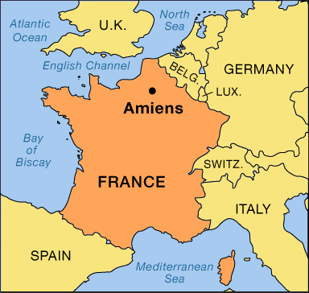
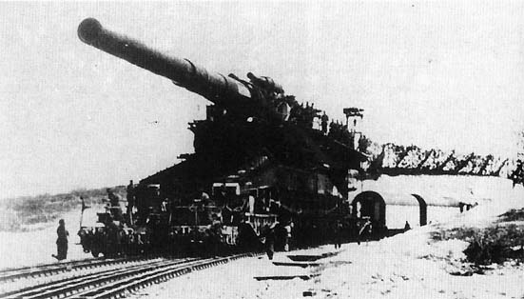
Rail Road Gun – Paris Gun
Notes:
The Paris Gun fired a 106 kilogram shell, driven by an explosive charge of 200 kilograms that produced an acceleration of 7,500 gees and a muzzle velocity of almost 6,000 kilometers per hour. The gun's maximum range was 126 kilometers, with the shell reaching a peak altitude of almost 42 kilometers during its three minutes of flight; the Paris Gun's shells were the first objects ever sent by humans out of the Earth's atmosphere and into space. The large powder charge melted the lining of the gun slightly every time it was fired. This meant that the shells had to be built in a numbered series, in a sequence of increasing diameters, to be fired in that order until the barrel was replaced and the cycle began again. The barrels were swapped out on a monthly basis.
Apparently a total of seven Paris Guns were built, with three put into action. The Germans obtained targeting information from spies in Paris, who relayed information through Switzerland on where the shells struck the city. The Paris Guns fired 350 rounds from March through August 1918, killing 256 people and wounding over 600. The Allies tried desperately to destroy the guns with artillery and aircraft, but the Germans camouflaged the guns and protected them in concrete emplacements when they were not in use. After the Armistice, the Allies tried to seize the big guns, but the Germans managed to spirit them away. To this day nobody is quite sure what happened to them.

Slide 8
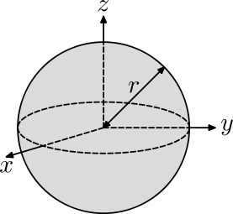
Coriolis Force Cont…Deflection of a falling mass
Ω
V=dr/dt
Notes:
Cross product of omega and r cap will be in the direction perpendicular to both which is theta cap. Similarly cross product of k cap and theta cap will give r cap.

Slide 9
Coirolis Force Cont…Deflection of a falling mass
Before releasing
After releasing
R
O
θ
O
A
A
Deflection of Falling mass = Rθ

Slide 10
Coriolis Force Cont…Deflection of a falling mass
Before releasing
After releasing
R
O
θ
O
A
A
Deflection of Falling mass = Rθ

Slide 11
Coriolis Force Cont…Deflection of a falling mass
Radial Equation of motion is
Speed of earth rotation is very high in comparison to speed of deflection
Notes:
Solve this radial equation and also the tangential equation.

Slide 12
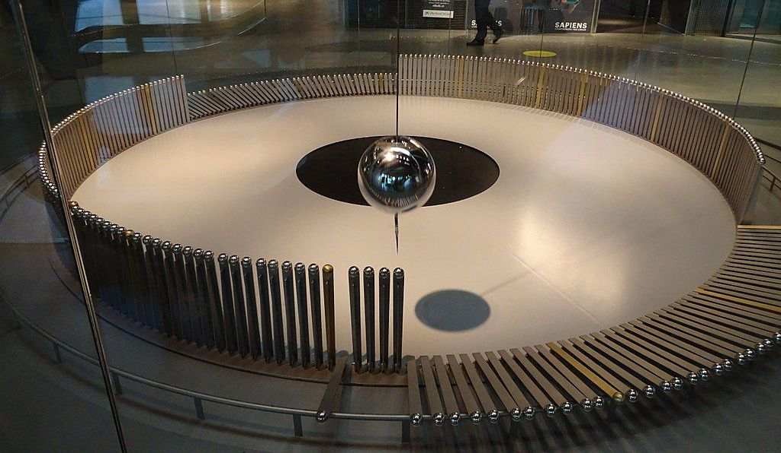
Time Period of Foucault Pendulum

Slide 13
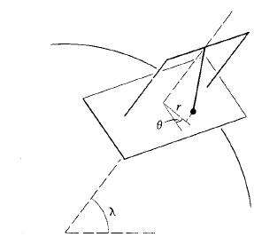
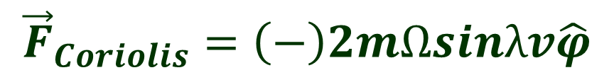
Mathematical Treatment
$${\vec{F}}_{Coriolis}=\left(−\right)2mΩsinλv\hat{φ}$$
Latitude λ determines the time period of precession of pendulum’s motion
For eg
Near the poles λ = 90º
Time period of precession = 24 hours
Empirically we can write
Time period of precession is inversely proportional to sinλ
Near the equator λ = 0º
Time period of precession = ?

Slide 14
Mathematical Treatment
Lets imagine that the Coirolis force is responsible for deflecting the motion of the pendulum
Notes:
In reality the effect of Coirolis force is negligible. It is the effect of earth’s rotation that causes the pendulum to precess.

